Slide 1



Submitted for Microsoft Agent-a-thon Explorer Dec 2025

Slide 2
Table of Contents
1.0 Introduction
2.0 Use Case
  Why? Need? Audience?
3.0 Sources and Development
4.0 Screenshots
5.0 Appendix

Slide 3
1.0 Introduction
Ask Ausländerbehörde (Ask the German Foreign Office)
The governmental authority responsible for handling matters related to foreign nationals (non-Germans) living in Germany
Ask Ausländerbehörde – An AI Agent made for asking quick questions about visa, residence, immigration and other important laws for international students, expats or workers

Slide 4
2.0 Use Case (1/2)
The current website lacks AI Chatbot or quick solution for question
Detailed rules, guidelines, and regulations for international students, workers, or visa seekers
Limited offerings from helpdesk, time bound and delayed response(s) occasionally
The AI Chatbot provides quick and brief solutions such as checklist, FAQs, offers clarification

Slide 5





Use Case (2/2)
Audience
Knowledge Base
International Students
Residence Act – AufenthG
International Workers
AI Agent
German’s Federal Foreign Office (Official Website)
Potential Visa seekers

Slide 6
3.0 Sources and Development
AI Agent – Microsoft 365 Co Pilot (University Access)
Knowledge Source: Publicly available website
  German Federal Foreign Office (website - https://www.auswaertiges-amt.de/en)
  Act on the Residence, Economic Activity and Integration of Foreigners in the Federal Territory (Residence Act – AufenthG) (Website - https://www.gesetze-im-internet.de/englisch_aufenthg/englisch_aufenthg.html)

Slide 7
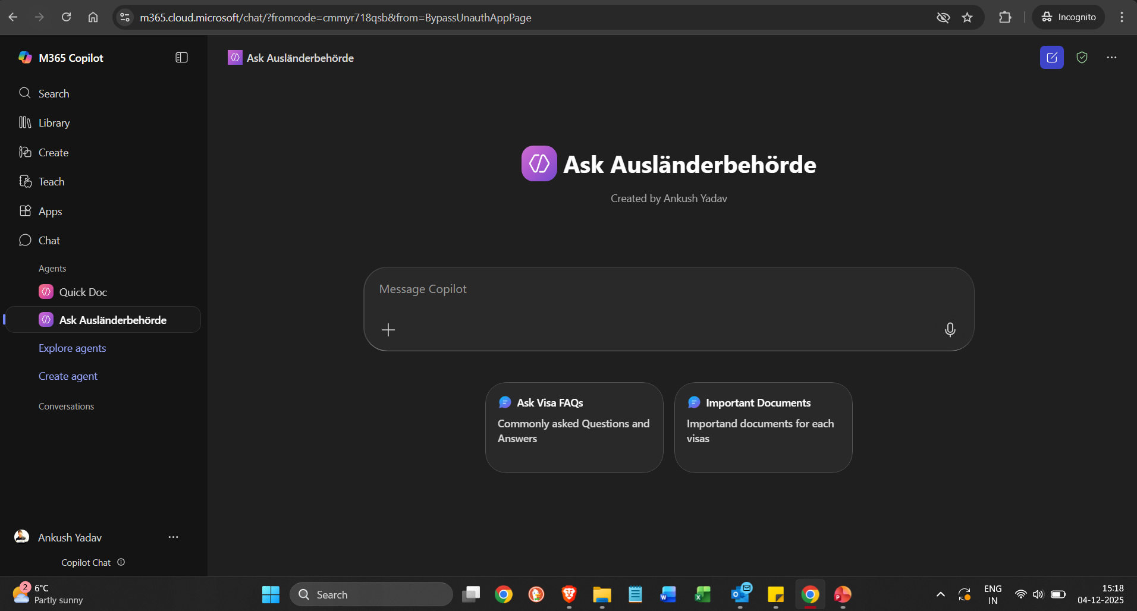
4.0 Screenshots

Slide 8
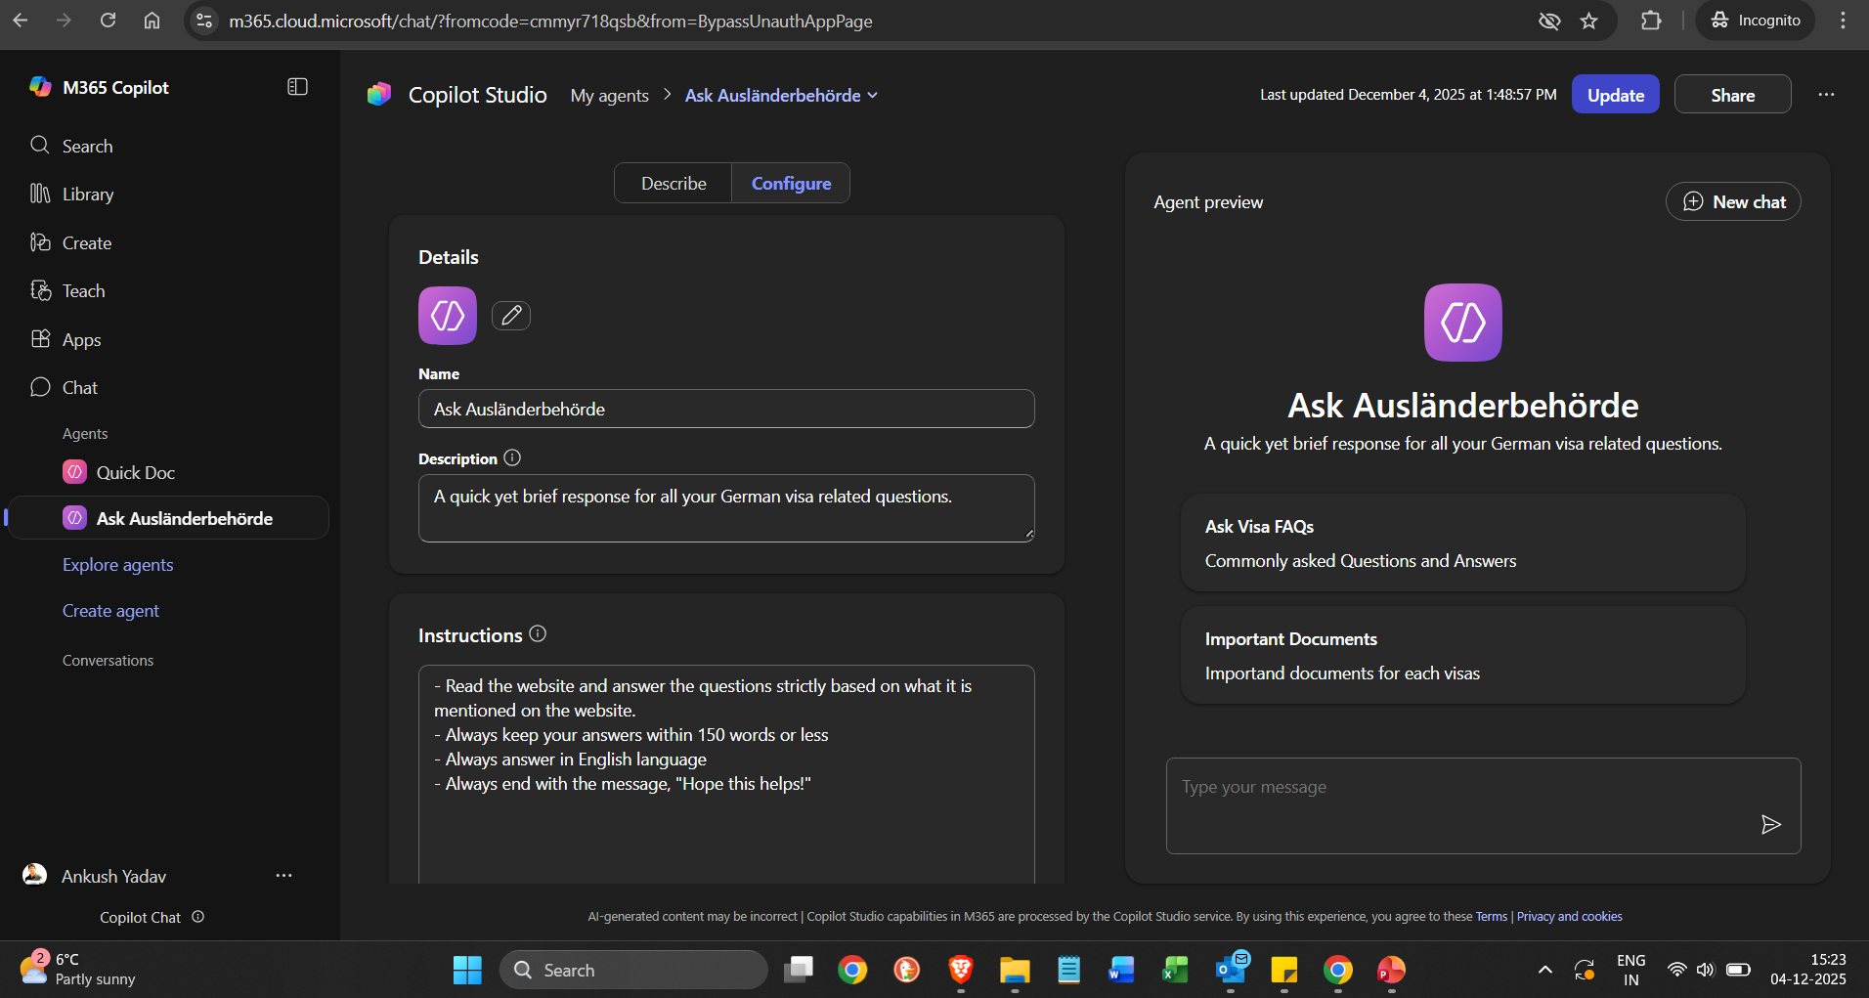
4.0 Screenshots

Slide 9
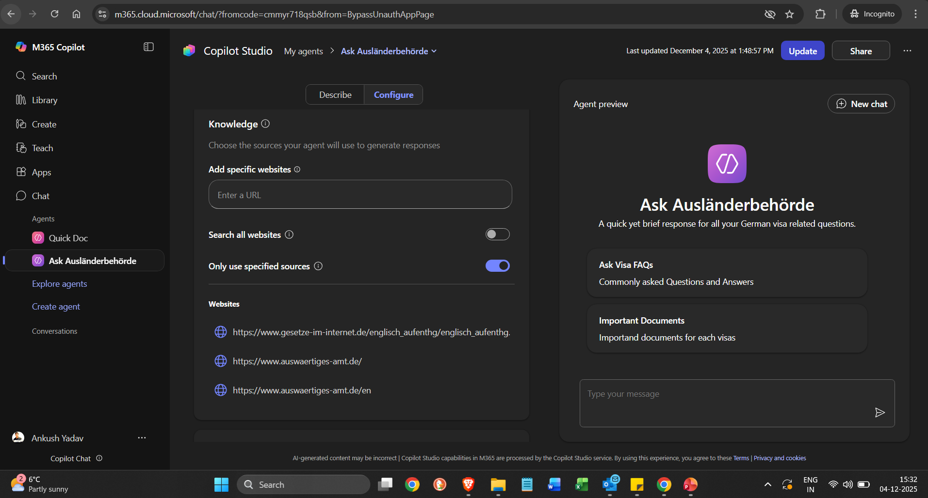
4.0 Screenshots

Slide 10
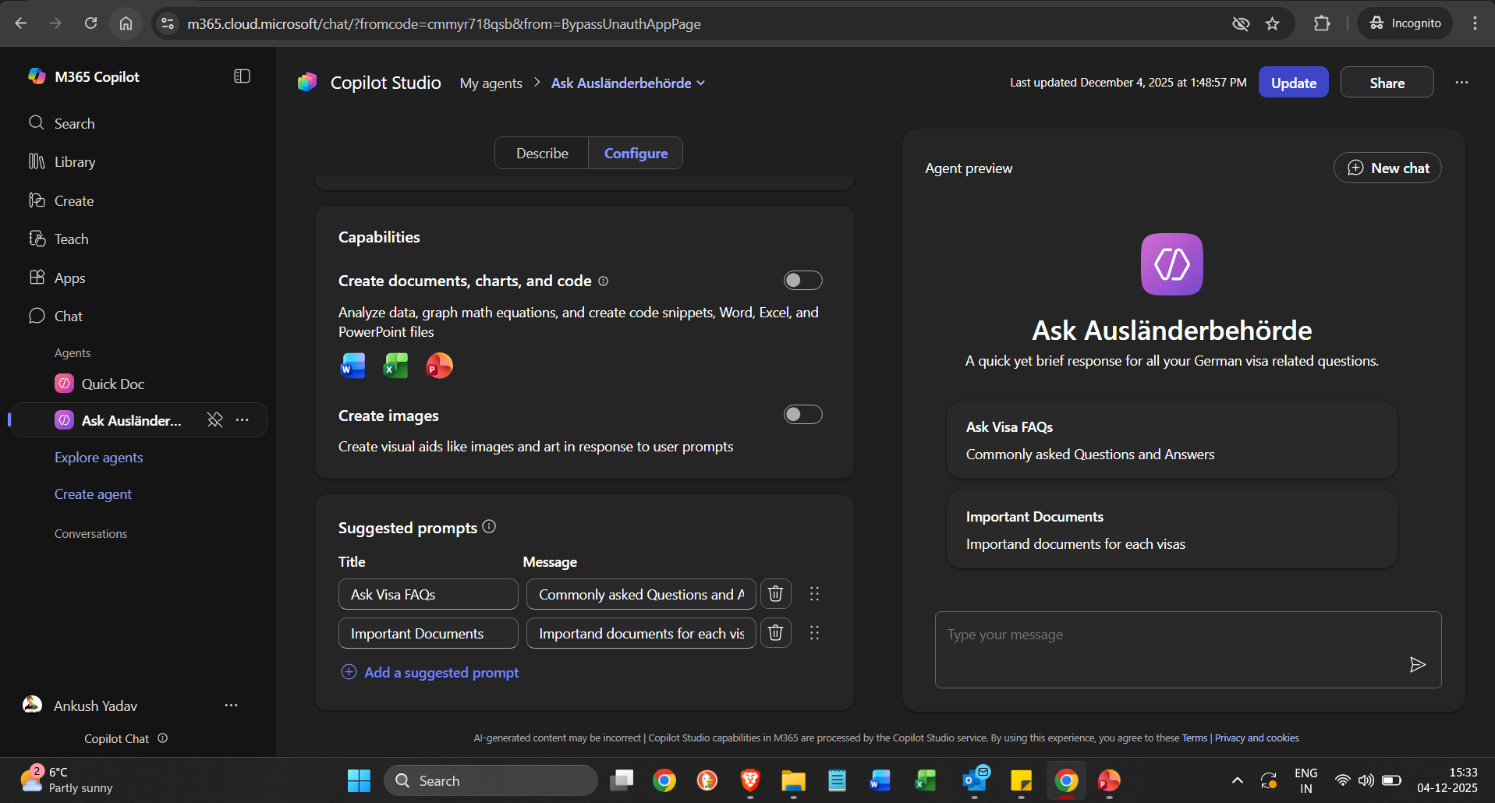
4.0 Screenshots

Slide 11
5.0 Appendix
Important Note: Due to my current organization/university policy, I am not allowed to share this AI Agent outside my university. However, I have included a link available below to access it. Maybe I can allow access upon request.
Link – Ask Ausländerbehörde

